Slide 1


Preparing for the Every Student Succeeds Act (ESSA) Accountability System Restart for the
2022-23 School Year

Slide 2


AGENDA:
Values and Vision
Accountability Restart Plan
  Indicator Shifts
  Modified Exit Criteria
Anticipated School and District Supports
Accountability Restart Timeline
Next Steps
2

Slide 3
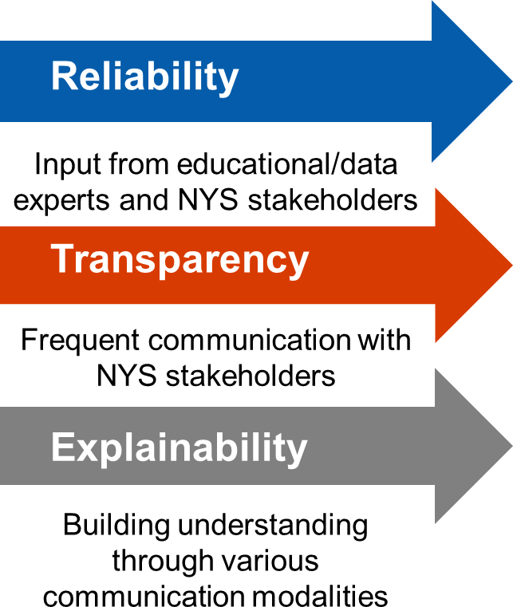
NYSED
Values
Guiding Accountability Restart
3

Slide 4

Curriculum Instruction Assessment
Continuous
SEL
Climate
Culture
Diversity Equity Inclusion
4

Slide 5
Changing the Narrative
Support Model
Identity
5

Slide 6
ESSA State Plan Addendum
Accountability waiver request denied by USDE on December 30, 2021
USDE mandating accountability and school improvement requirements under the ESEA using data from the 2021-2022 school year
USDE allowing State Education Agencies (SEAs) to submit a 2021-2022 ESSA State Plan Addendum
Amendments will impact accountability determinations made based on data from the 2021-2022 school year and school identifications in the 2022-2023 school year.
Plan amendments for the 2021-2022 school year only
12

Slide 7
USDE Accountability Restart Constraints
According to USDE Guidelines:
Each SEA is required to annually measure the achievement of not less than 95 percent of all students and students in each subgroup on its annual statewide assessments in reading/language arts and mathematics under ESEA section 1111(c)(4)(E).
An SEA may not use indicators that are not in use statewide.
An SEA must run its accountability system for purposes of identifying at least the current lowest-performing five percent of Title I schools in fall 2022 based on data from the 2021-22 school year and may not carry over a previous year’s list of identified schools.
SEAs may exclude students from the high school participation and performance
calculations for the 2019-20 school year, but not in subsequent years for which an assessment waiver was not provided.
7

Slide 8
USDE Accountability Restart Flexibilities
According to USDE Guidelines:
A State Education Agency (SEA) may make one-year or longer-term changes to its approved ESEA consolidated State plan, consistent with ESEA requirements.
An SEA may consider changes to Long-Term goals and Measurements of Interim Progress (MIPs) for Academic Achievement, Graduation Rates, and Progress in Achieving English Language Proficiency (ELP) due to the impact of COVID-19 and resulting disruptions on school performance.
An SEA has discretion to modify its methodology for its system of annual meaningful differentiation, which must include all schools in the State and be based on all indicators (or may replace the Other Academic Indicator).
8

Slide 9
Restarting the Accountability System
After receiving stakeholder input, extensive modeling, and data analysis, the proposed accountability system restart for the 2022-2023 school year will...
Modified Exit Criteria
Start with a one-year model that relies on 2021- 2022 school year data
Suspend the use of several indicators
Modify the use of several indicators
Introduce a new indicator
Use modified scenario tables for identification
Use modified exit criteria
Modified Scenario Tables
Modified Accountability Indicators
15

Slide 10
Plan Amendments: Accountability Indicators for 2021-22 SY
Elementary/Middle | High School
Weighted Average Achievement* | Weighted Average Achievement**
Core Subject Performance* | Core Subject Performance**
ELP | ELP
Chronic Absenteeism | Chronic Absenteeism
 | Graduation Rate
Note: For all the indicators except ELP, rank-based cut-points will be used to assign levels
Indicators dropped for 2021-22 SY
Elementary/Middle | High School
Academic Progress | Academic Progress
Growth | CCCR
* Grades 3-8 ELA, Grades 3-8 Math, and Grades 4 and 8 Science
** Four-Year Cohort results for ELA, Math, Science, and Social Studies

Slide 11
Plan Amendments: High School Accountability Indicators
USDE will only allow students with a Regents exemption from the 2019-20 spring administration to be excluded from Composite Performance calculations. For the 2021-22 SY, NYSED will split high school Composite Performance into Weighted Average Achievement and Core Subject Performance. The Performance Indices will be calculated using the following formula:
100 *
𝐿𝑒𝑣𝑒𝑙 2 +2 𝐿𝑒𝑣𝑒𝑙 3 +2.5(𝐿𝑒𝑣𝑒𝑙 4)
𝐷𝑒𝑛𝑜𝑚𝑖𝑛𝑎𝑡𝑜𝑟
Weighted Average Achievement Denominator: # of students in accountability cohort with or without test scores
Core Subject Performance Denominator: # of students in accountability cohort who are tested
Example: Weighted and Core Performance Indices Calculation
Subject | Cohort Count | Tested | Exempt | #L1 | #L2 | #L3 | #L4 | Numerator | Wtd. Denom | Core Denom | Wtd. PI | Core PI | Weight
Math | 100 | 60 | 40 | 4 | 16 | 25 | 15 | 104 | 100 | 60 | 104 | 173 | 3
ELA | 100 | 20 | 80 | 1 | 5 | 10 | 4 | 35 | 100 | 20 | 35 | 175 | 3
Science | 100 | 80 | 20 | 5 | 10 | 15 | 50 | 165 | 100 | 80 | 165 | 206 | 2
Social Studies | 100 | 50 | 50 | 1 | 4 | 10 | 35 | 112 | 100 | 50 | 112 | 223 | 1
The Wtd. Achievement Index will be 95.2 and Core Subject Performance Index will be 186.4

Slide 12
Regents Exams for a Typical 2018 Cohort Student
Year | Math | Science | Social Studies | ELA
2018-2019 | Algebra I CC | Earth Science | N/A | N/A
2019-2020 | Geometry Exemption | Living Environment Exemption | World History Exemption | N/A
2020-2021 | Algebra II CC | Physics or | US History | ELA CC
2021-2022 | N/A | Chemistry | N/A | N/A
For the Weighted and Core Indices calculation the student’s highest Regents score in each subject area is used. Most students in the 2018 Cohort will not have a social studies Regents score unless they took an approved Regents alternative such as AP World History or AP US History.
Approved Regents Alternatives
Math | Science | Social Studies | ELA
AP Calculus AB AP Calculus BC IB Math HL IB Math SL IB Math Studies SL | AP Biology | AP World History AP US History | AP Lang & Comp AP Lit & Comp

Slide 13
Accountability Statuses
Schools are identified for:
Comprehensive Support & Improvement (CSI)
  Bottom 5% of low performing schools
  All Students 4-year graduation rate is less than 67% (5-year and 6-year graduation rate not 67% or more)
Additional Targeted Support & Improvement (ATSI)
  Identified for TSI in the 2018-19 SY
  Identified for TSI the 2019-20 SY and the subgroup meets the CSI identification criteria based on 2021-22 SY results
Targeted Support & Improvement (TSI)
  Low performing subgroups (excluding the All Students group) that met the scenario identification criteria for two years
Districts are identified as Target Districts if
Any component school is identified for CSI, ATSI, or TSI
Any district level subgroup meets the scenario identification criteria two years in a row
Proposed Update: Good Standing will be known as Local Support and Improvement (LSI) going forward.
Definition remains unchanged (schools and districts that are not identified for CSI, ATSI, TSI, or Target District)

Slide 14
Plan Amendments: Identification Methodology
Elementary/Middle Level Pre-Pandemic CSI /TSI Scenario Table
Scenarios | Composite Performance | Growth | Combined Composite Performance & Growth | ELP | Progress | Chronic Absenteeism
1 | Both Level 1 |  | Level 1 | Any Level (None, 1-4) | Any Level (None, 1-4)
2 | Either Level 1 |  | Level 1 | None* | Any One of the Two is Level 1
3 | Either Level 1 |  | Level 1 | Level 1 | Any Level (None, 1-4)
4 | Either Level 1 |  | Level 1 | Level 2 | Any One of the Two is Level 1
5 | Either Level 1 |  | Level 1 | Level 3 or 4 | Both Level 1
Prior to the Pandemic
High School Level Pre-Pandemic CSI /TSI Scenario Table
Scenarios | Composite Performanc e | Graduatio n Rate | Combined Composite Performance & Graduation Rate | ELP | Progress | Chronic Absenteeism | College, Career, and Civic Readiness
1 | Both Level 1 |  | Level 1 | Any Level (None, 1- 4) | Any Level (None, 1-4)
2 | Either Level 1 |  | Level 1 | None* | Any One of the Three is Level 1
3 | Either Level 1 |  | Level 1 | Level 1 | Any Level (None, 1-4)
4 | Either Level 1 |  | Level 1 | Level 2 | Any One of the Three is Level 1
5 | Either Level 1 |  | Level 1 | Level 3 or 4 | Any Two of the Three are Level 1

Slide 15
Plan Amendments: Identification Methodology
Elementary/Middle-Level CSI/TSI Scenario Table
Scenarios | Weighted | Core | ELP | Chronic Absenteeism
1 | Both Level 1 |  | Any Level (Non, 1-4)
2 | Level 2 | Level 1 | Both NOT Level 3 or 4
3 | Level 1 | None | Both NOT Level 3 or 4
4 | Level 1 | Level 2 | Both NOT Level 3 or 4
5 | Level 3 | Level 1 | Both NOT Level 3 or 4
6 | Level 1 | Level 3 | Both NOT Level 3 or 4
Identification Method for 2022-23 School Year Determinations
High School Level CSI/TSI Scenario Table
Scenarios | Weighted | Core | Grad Rate | ELP | Chronic Absenteeism
1 | Both Level 1 |  | Level 1 | Any Level (None, 1-4)
2 | Level 2 | Level 1 | Level 1 | Both Not Level 3 or 4
3 | Level 1 | None | Level 1 | Both Not Level 3 or 4
4 | Level 1 | Level 2 | Level 1 | Both Not Level 3 or 4
5 | Both Level 1 |  | Level 2 | Both Not Level 3 or 4
6 | Level 1 | Level 2 | Level 2 | Both Not Level 3 or 4
7 | Level 2 | Level 1 | Level 2 | Both Not Level 3 or 4

Slide 16
Schools identified for CSI or ATSI
Weighted Average Achievement or Core Subject Performance Index is higher than at the time of identification (2017-18 SY)
Graduation Rate (average 4,5,6) is higher than at the time of identification (2017-18 SY)
Plan Amendments: Exit Criteria
Schools identified for TSI
If the school does not meet the TSI identification criteria in 2021-22, then it will exit status.
Exit Criteria based on 2021-22 SY results
Target District
Exit all Target Districts that are identified at the district level only.
All component schools identified for CSI/ATSI/TSI for its own subgroup meets the exit criteria and does not meet the respective subgroup identification criteria using 2021-22 SY data.
Additionally, all CSI and TSI Schools in the district must exit using
2021-22 SY data
Note: Participation rate improvement plan requirement is waived.

Slide 17

SCHOOL AND DISTRICT SUPPORT MODELS
Types of Support:
Schools and districts identified for Local Support and Improvement (LSI) – Local determination of continuous improvement process
Schools identified for Targeted Support and Improvement (TSI) – Primarily district support within NYSED constructs and requirements for improvement planning
Schools identified for Additional Targeted Support and Improvement (ATSI) – State support
Schools identified for Comprehensive Support and
Improvement (CSI) – State support
Schools identified for Receivership – State support

Slide 18

2022-2023 SUPPORT OPPORTUNITIES
Four Types of Available Support:
Ongoing Field Support
Network Convenings
Professional Learning
Coaching

Slide 19
USDE-Approved Addendum
Board of Regents Adopts Emergency Regulations
ESSA
Determinations
Next Steps
Public Comment Period
Preliminary Determinations
Formal Appeals to Commissioner
Final Determinations

Slide 20






Continuing the Conversation
Partnering with Stakeholder Groups
Visioning
Communication
Training
Support
Next Phase of Implementation

Slide 21
NYSED Accountability Website
Additional Resources
FAQs
How Accountability Works (Forthcoming)

Slide 22


Questions?
Accountability ?s: Accountinfo@nysed.gov
Thank you!
Field Support ?s:
fieldsupport@nysed.gov
SIG Funding ?s:
SIGA@nysed.gov
ESSA Funded Programs: Conappta@nysed.gov

